Slide 1
Coffee Café
Prototype

Slide 2
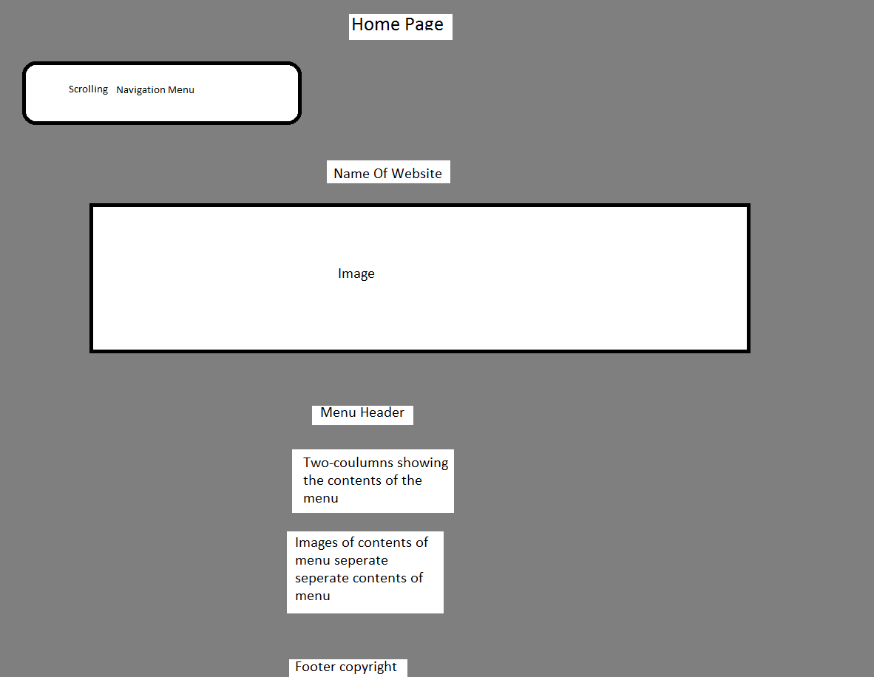
Draft home page

Slide 3
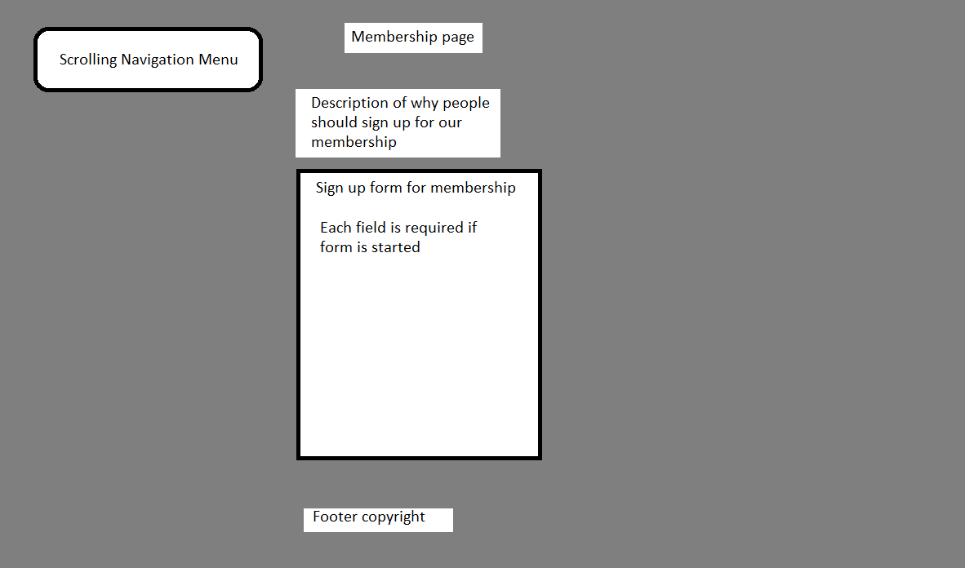
Draft Membership

Slide 4
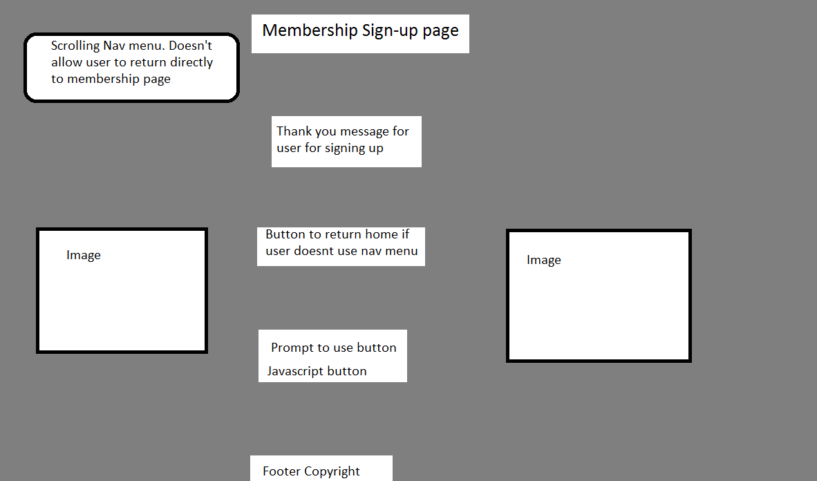
Draft sign up/redirect

Slide 5
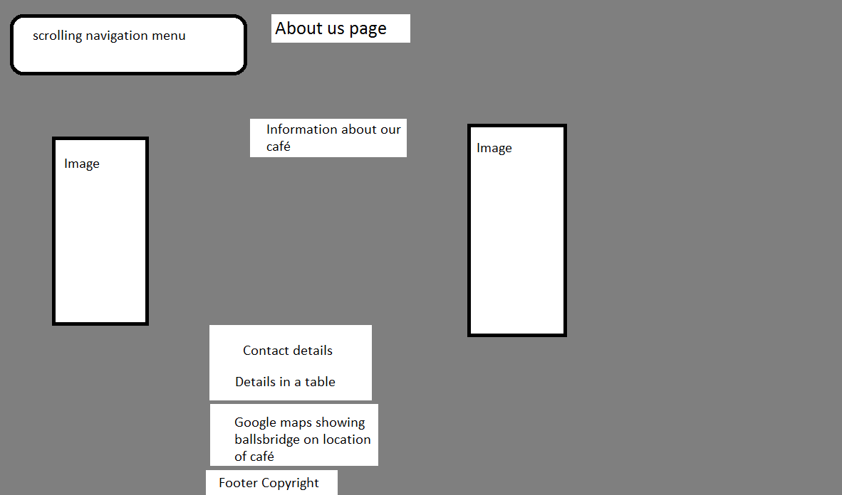
Draft About us page

Slide 6

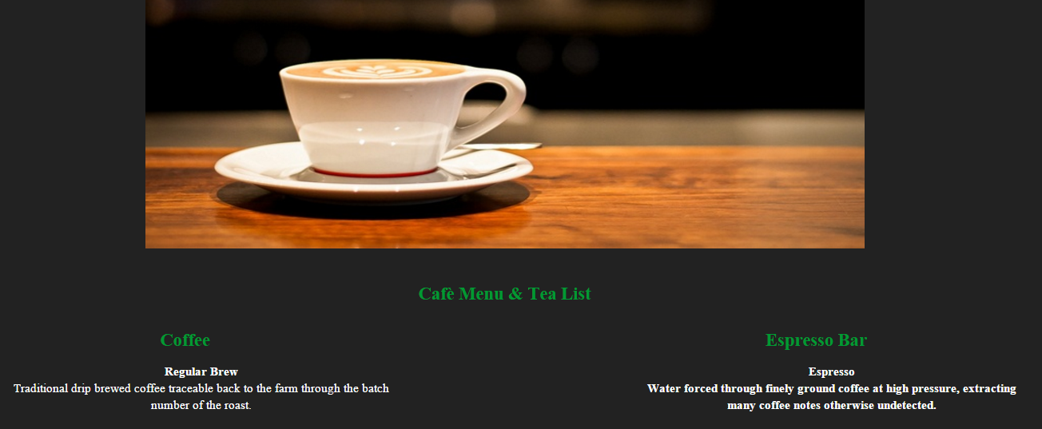
Home Page

Slide 7
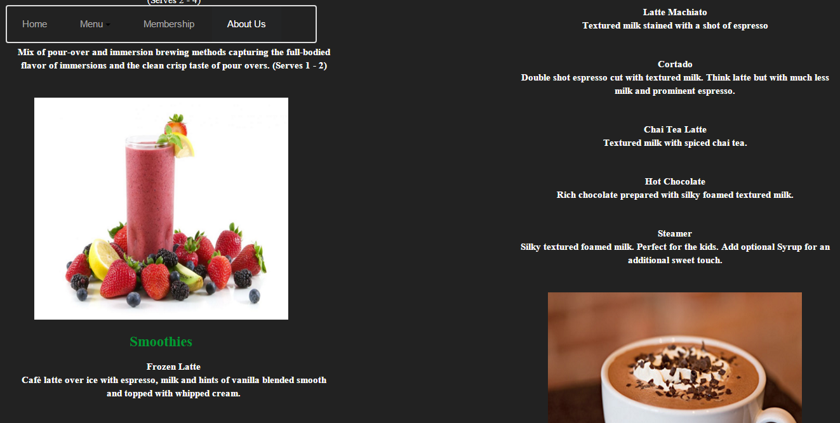
Home Page

Slide 8
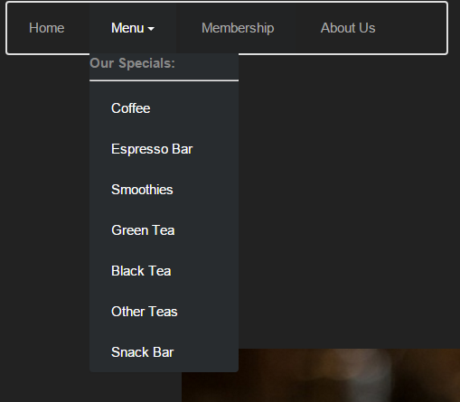
Navigation Menu Allows user to navigate through the website, the menu navigates through several areas of the home screen while membership and about us bring the user into different pages. After signing up, you are redirected to a thank you page.

Slide 9
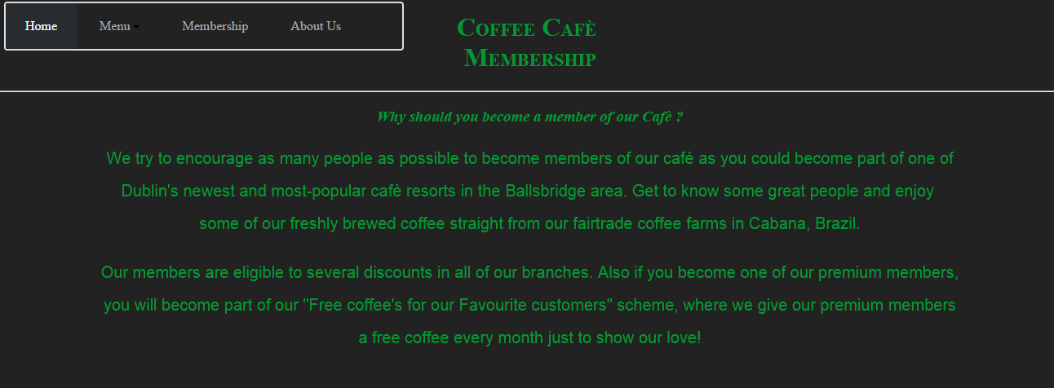
Membership Page

Slide 10
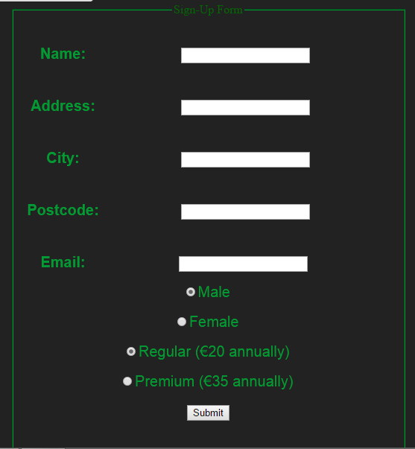
Membership Page

Slide 11
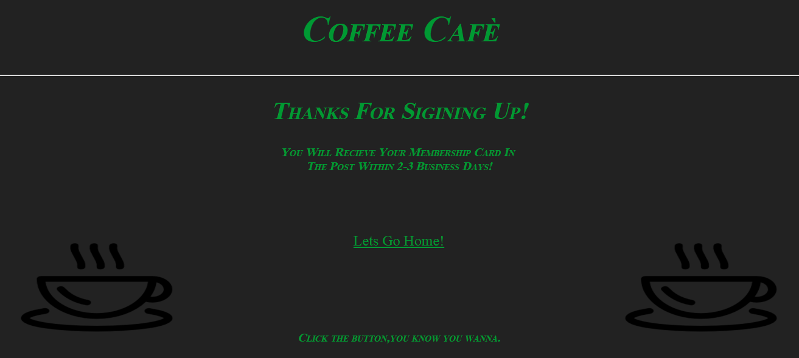
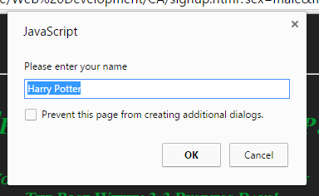
Sign up Page

Slide 12
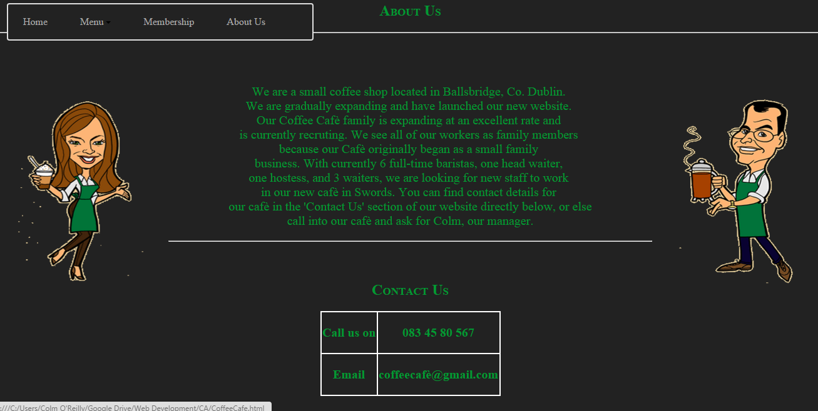
About Us Page

Slide 13
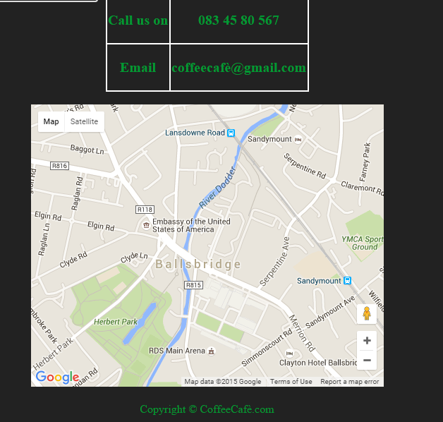
About Us Page

Slide 14
Neilsons Heuristics
There’s a navigation menu and description on each page to describe what’s going on.
An English description of what’s going on is present
The user can navigate through each page and interact with each page
The site is very consistent with interaction, colours and font etc.
When filling out the form each sector is required if the user goes to leave the page without submitting
All of the information is visible in front of the user and doesn’t have to remember anything
The user can go back and change their sign up information details
All info is relevant, looks relatively okay with colour schemes
Errors are displayed in english
Help very rarely has to be offered as there can be little or no errors

